Slide 1
Automated Resume Screening
A project based on Machine Learnng and Natural Language Processing.
By
Arya Barman (506)
Srijani Dutta (516)
Pameli Sensharma (536)
Supervisor: Prof. Debabrata Datta

Slide 2
Objectives
•To automate the resume screening process and reduce manual effort in recruitment.
•To analyze resume content using Natural Language Processing (NLP).
•To classify resumes into job categories based on skills, education, and experience.
•To improve accuracy and consistency in candidate shortlisting.
•To reduce recruitment time by quickly filtering large numbers of resumes.
•To identify the most suitable candidates for specific job roles.
•To evaluate model performance using metrics such as Accuracy, Precision, Recall, F1-score, and Cross-Validation Accuracy.
•To support better hiring decisions through data-driven screening.

Slide 3
Problem Statement
•Reduces manual effort in screening resumes.
•Saves time during recruitment.
•Handles large volumes of resumes efficiently.
•Improves consistency in candidate selection.
•Minimizes chances of missing qualified candidates.
•Supports faster and smarter hiring decisions.
•Handles human bias and inconsistency

Slide 4
Proposed Solution
Resume → NLP Processing → ML Model → Prediction and Ranking
•Replace manual checking and implement intelligent automated classification system
•Use NLP for Text Analysis
•Apply Machine Learning Classification
•Use data-driven decisions to reduce human errors and maintain fair screening.
•Improve Accuracy and Consistency
•Performance Monitoring

Slide 5
Requirements Specification
Operating System
Windows 10/11
macOS
Python Libraries and Frameworks:
NumPy
Pandas
Matplotlib
Seaborn
scikit-learn
NLTK
re
Programming Languages
Python for Machine Learning.
Frontend: HTML, CSS, JavaScript
Backend: Flask and Python
Development Environment
Jupyter Notebook
VS Code
Input/Ouput
Resume dataset in .csv
Resume files in .pdf , .txt, .docx

Slide 6
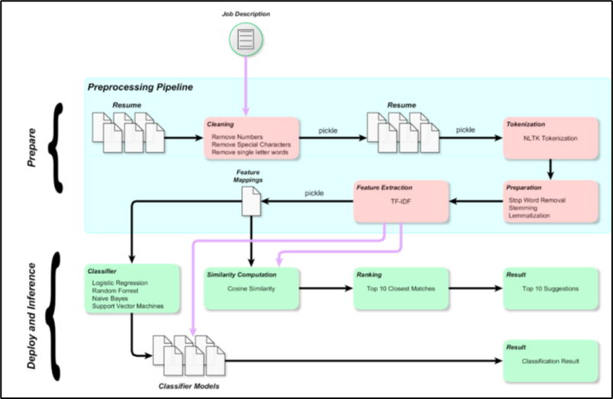
System Architecture
Fig. A workflow diagram of the proposed model (Ref. A Machine Learning approach for Automated Resume Recommendation System, ICCIDS 2019)

Slide 7
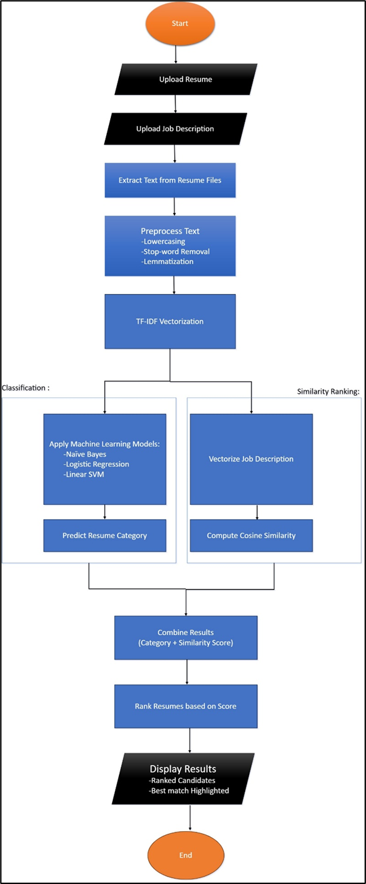
System Architecture
Fig. Flowchart for the System
Fig. Flowchart contd.

Slide 8
Project Components
Data Collection and Preprocessing
Gather a dataset of resumes, in PDF or DOCX Format.
Clean the text by removing irrelevant elements.
Preprocessing text to prepare it for feature extraction and model training.
Feature Engineering
Using methods like Term Frequency-Inverse Document Frequency) to convert text into numerical vectors that machines can understand.

Slide 9
Project Components
Model Training
Build a Machine Learning model to predict a job category to score resumes..
Using Algorithms like Naive Bayes, Logistic regression and Linear SVM to train the system.
Evaluation metric used: Accuracy, F1 Score, Confusion Matrix.
Matching and Ranking
Used Cosine Similarity to match the keywords of the job description to the resume keywords.
Ranked the candidates who are most suitable.

Slide 10
Project Components
Output
Predicted Category
Match Score
Best Candidate
Web Interface
User inputs the job description.
User uploads resumes in .pdf, .docx or .txt format
Shows the best candidate along with match score.

Slide 11
Algorithm
Input Collection
Uploads Resumes
Enter Job Description
Rseume.csv dataset is used to train the model.
Data Cleaning and Preprocessing.
Lowercasing
Stopword removal
Lemmatization

Slide 12

Algorithm
3. Feature Extraction
TF-IDF Vectorization : assigns weights to terms based on their importance
within a document relative to the entire dataset.
4. Model Training and Classification:
Learns patterns from skills, keywords and experience.
Trained on labeled resume dataset
Algorithms Used :
Naive Bayes
Logistic Regression
Linear Support Vector Machine

Slide 13


Algorithm
Naïve Bayes: Calculates probability of a resume belonging to each category
Chooses the category with highest probability
Logistic regression:
Takes weighted sum of input features
Applies sigmoid function
Outputs probability between 0 and 1

Slide 14
Algorithm
Linear Support Vector Machine
Works by finding the optimal hyperplane that separates different classes with the maximum margin.
Where, w : weights
x: input features(TF-IDF values)
b: bias
Advantages:
Works well with high-dimensional data (TF-IDF)
Effective even when features > samples
Strong generalization capability
Less overfitting compared to some models

Slide 15

Algorithm
Model Training and Classification contd.
Evaluation Metric: Accuracy, F1 Score, Confusion Matrix
Best model selected based on performance and accuracy.
5. Similarity Computation using Cosine Similarity
Where, A represents the vector corresponding to a resume and represents the vector corresponding to the job description.

Slide 16
Algorithm
6. Resume Ranking
Resumes are ranked based on similarity score.
7. Output Generation
Displays final results to the user.
Displays the category, match score and the best candidate.

Slide 17
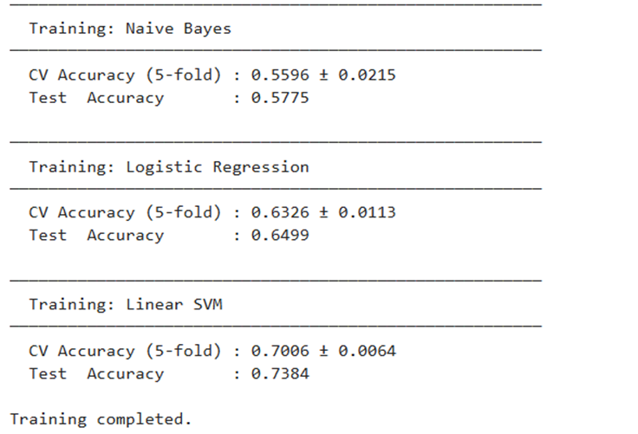
Results
Model Performance:
Compares performance of multiple models to select the best one

Slide 18
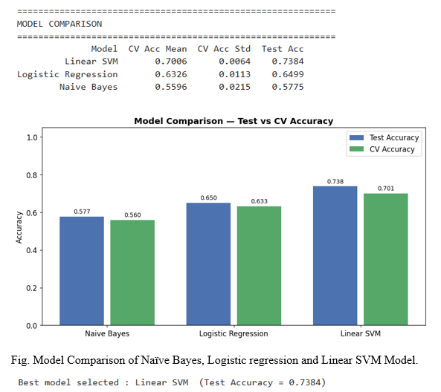
Results
Model Performance:

Slide 19
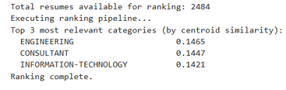
Results
Resume Ranking
The user adds the job description:We are looking for an experienced Data Scientist with a strong background in machine learning, statistical modelling, and data analysis. The ideal candidate should have proficiency in Python and R, experience with frameworks such as scikit-learn, TensorFlow, or PyTorch, and the ability to communicate complex findings to non-technical stakeholders. Responsibilities include developing predictive models, performing exploratory data analysis, building data pipelines, and collaborating with cross-functional teams. Experience with SQL databases, cloud platforms (AWS, GCP, or Azure), and big data tools such as Spark is advantageous. A bachelor's or master's degree in Computer Science, Statistics, Mathematics, or a related field is required.

Slide 20
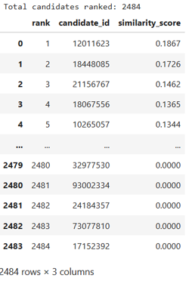
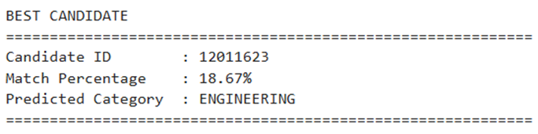
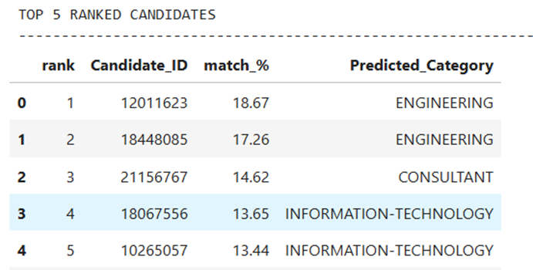
Results
All the resumes ranked using similarity score.
Best Candidate:
Top 5 Candidates:

Slide 21
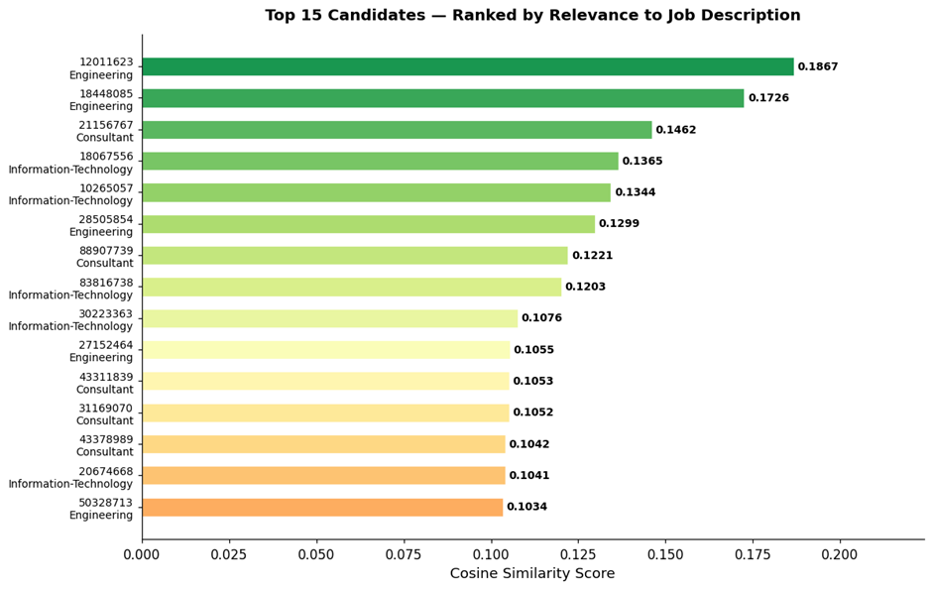
Results
Fig. Top 15 candidates ranked by relevance to job description.

Slide 22
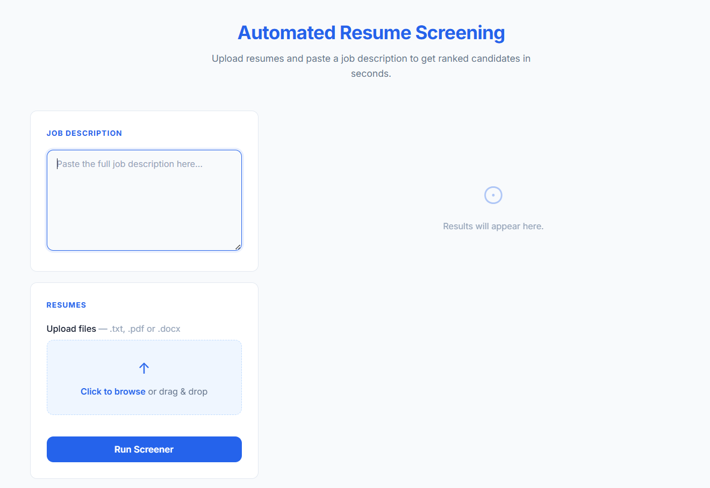
Results
Web Application:

Slide 23
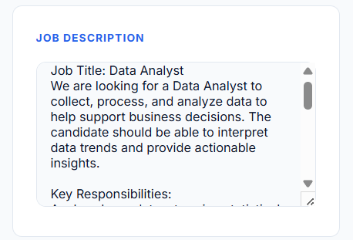
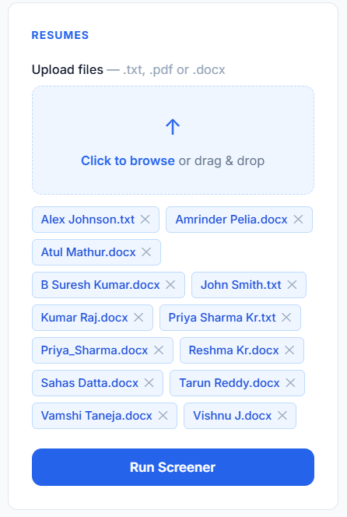
Results
The user inputs the job description and uploads all the resumes required to be ranked:

Slide 24
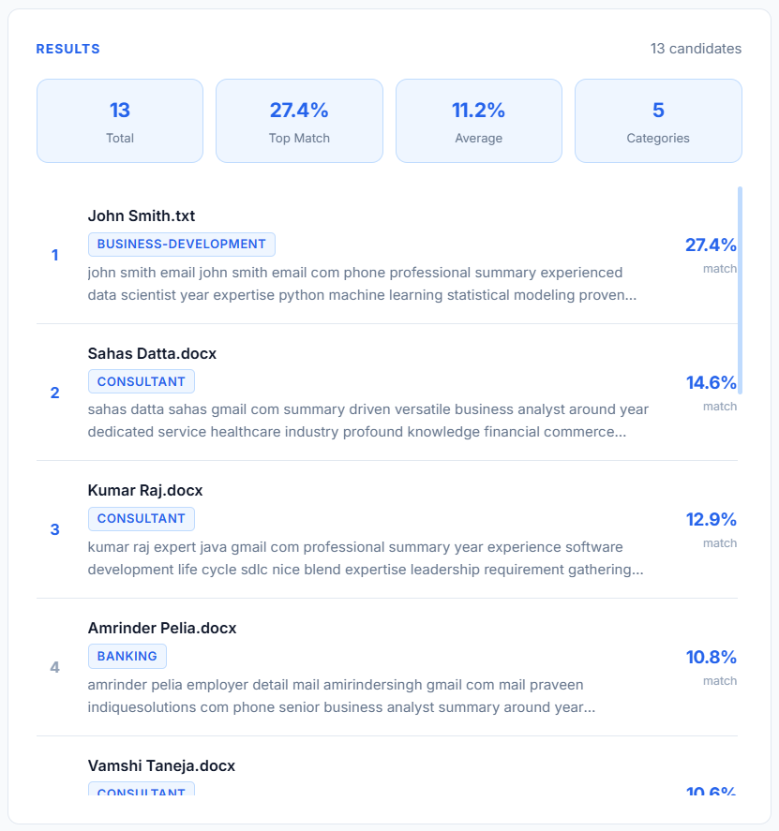
Results
Candidates are ranked and the score is shown.

Slide 25
Advantages
1. Saves Time
2. Faster Hiring Process
3. Reduces Human Bias
4. Improves Accuracy
5. Cost Effective
6. Handles Large Volume Easily
7. Consistent Evaluation
8. Better Candidate Experience

Slide 26
Limitations
1. Over-Reliance on Keywords
2. Can Miss Qualified Candidates
3. Lacks Human Judgment
4. Bias in Algorithms
5. Formatting Issues
6. High Initial Setup Cost
7. Not Fully Reliable
8. Limited Understanding of Experience

Slide 27
Future Scope
1. Use of Advanced AI & Machine Learning
2. Better Skill Matching
3. Integration with Other HR Tools
4. Improved Bias Reduction
5. Use of Natural Language Processing (NLP)
6. Real-Time Candidate Screening
7. Personalized Feedback to Candidates
8.Voice & Video Resume Analysis

Slide 28
Conclusion
Automated resume screening is transforming the recruitment process by making hiring faster, smarter, and more efficient. It helps organizations handle large volumes of applications with ease while ensuring consistency and saving valuable time.
However, despite its advantages, it is not a complete replacement for human judgment. Factors like creativity, personality, and real-world experience still require a human touch.
Looking ahead, with advancements in Artificial Intelligence and Machine Learning, automated screening systems will become more accurate, fair, and intelligent. The future of hiring lies in a perfect balance between technology and human decision-making.

Slide 29
References
Elakkiya R., & Muthuraj Kumar S. (2021). "Automated Resume Screening System using Semantic Similarity". In 2021 International Conference on Computing, Electronics & Communications Engineering (ICCECE).
Pradeep Kumar Roy, Sarabjeet Singh Chowdhary (2019), “A Machine Learning approach for Automation of Resume Recommendation System”. - International Conference on Computational Intelligence and Data Science (ICCIDS).
Mandviwalla, M., & Kappelman, L. A. (2021). "Automated Resume Screening Using Semantic Similarity and Machine Learning". Journal of Information Systems Education.
Tejaswini K, Umadevi V, Shashank M Kadiwal, Sanjay Revanna .“Design and development of Machine Learning based Resume Ranking System”
Daryani C. Chhabra, G.S. Patel, H. Chhabra, I.K. & Patel R. (2020). “An Automated Resume Screening System using Natural Language Processing and Similarity”. Topics in Intelligent Computing.
Khatri V. (2025). “AI-Powered Automated Resume Screening and Job Matching System using NLP and Machines Learning”. IJRESM.
Mohammed Shinan, K.S. Praveen, G.P.P. & Varsha, C.R. (2025). “AI-Powered Resume Screening and Categorization Using Machine Learning and NLP”. International Journal of Innovative Research in Technology

Slide 30
References
Bird S. Klein, E. & Loper (2009). “Natural Language Processing with Python”. O’Reilly Media
Tunchalp A. (2016). “Automated Resume Screening Using Text Mining.” International Journal of Advanced Computer Science and Applications.
Roy P. K. Chowdhary, S. Bhatia, R. (2020). “A Machine Learning approach for automation of Resume Recommendation System”. Procedia Computer Science.
Lohith G. K., Varshith Reddy, K. Mounisha Reddy, P. & Vinya V. L., 2025. “NLP‑Based Resume Analysis, Skill Enhancement & Job Automation”. International Research Journal of Engineering and Technology (IRJET).
Rudrakar, M., Tayade, S., Wankhede, D., Khan, U., & Gaikwad, G., 2025. “An Intelligent System for Automated Resume Screening and Resume Building Using NLP and Machine Learning”. International Journal of Innovative Research in Technology.
Saatçı, Kaya, R.R. (2024). “Resume Screening with Natural Language Processing (NLP)”. IJRESM.
Jurafsky, D., & Martin, J. H. (2021). “Speech and Language Processing” (3rd ed.). Pearson.
Goyal, A., Gupta, V., & Kumar, M. (2018). “Deep Learning for Natural Language Processing: A Survey.” ACM Computing Surveys.

